Slide 1
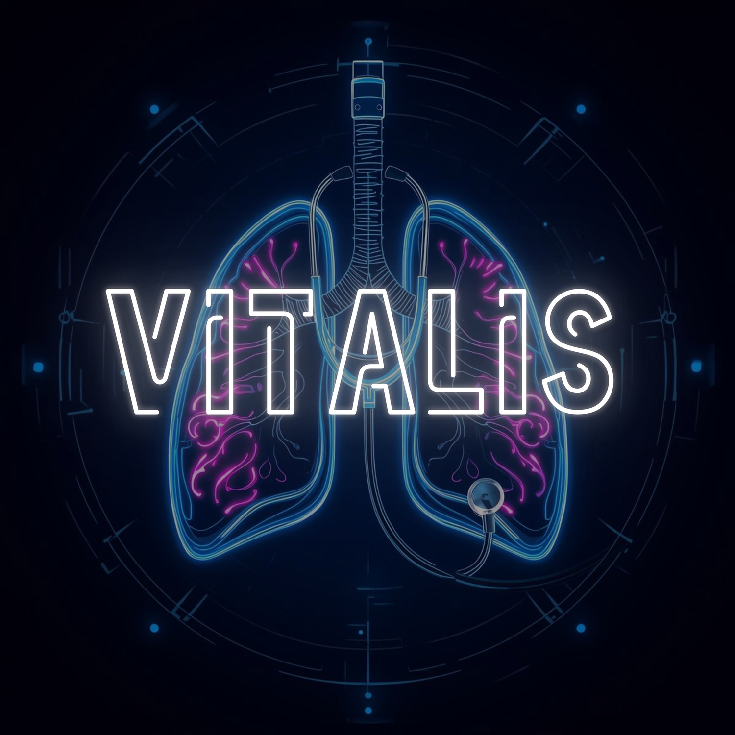


CBSE AI Practical 2026-27
Pradhumya Singh Yadav | Dhairya Chaudhary | Aryan Chauhan
Jagran Public School Noida
Class: XIIth
01

Slide 2



Diagnostic Gap: The inability of non-specialist health workers to accurately distinguish between complex respiratory sounds leads to high misdiagnosis rates.
₹
Inaccessible Technology: Advanced digital stethoscopes cost upwards of ₹35,000, making AI diagnostic tools unaffordable for local clinics and rural PHCs.
Problem
The "Trial-and-Error" Risk: Local doctors often prescribe generic medication for serious symptoms, wasting critical time while underlying infections like Pneumonia worsen.
Critical Referral Delays: lack of early, objective detection for high-risk conditions results in late-stage hospitalizations and increased mortality in respiratory cases.
02

Slide 3
The Opportunity
Real-time AI classification allows local doctors to identify high-risk pathologies instantly, ensuring life-saving treatment begins days earlier.
Using low-cost, off-the-shelf hardware and open-source AI, this solution can be rapidly deployed across global regions with limited medical resources.
Converting analog breath sounds into digital data enables the creation of a longitudinal health record for better patient monitoring and follow-up.
By reducing the cost of digital stethoscopes by 80%, we can equip every ASHA worker and rural clinic with specialist-level screening tools.

Slide 4
1
VITALIS uses an embedded neural network to instantly translate raw lung sounds into clinical labels like "Normal," "Wheeze," or "Crackle."
2
By utilizing a high-fidelity I2S MEMS microphone, the device captures crystal-clear respiratory data without the electrical noise of traditional analog sensors
Our Idea
3
All AI inference is performed locally on the XIAO C6 microcontroller, ensuring diagnostic results are available in under 6ms without needing an internet connection.
4
The system provides a standardized "second opinion" to local healthcare workers, reducing human error and ensuring high-risk patients are referred to hospitals immediately.
04

Slide 5



Benefits
Prevention of Critical Complications
Elimination of Diagnostic Subjectivity
Enables early detection of high-risk pathologies, allowing for timely hospital referrals and reducing the risk of minor infections turning into emergencies.
Replaces inconsistent human hearing with a standardized AI model, ensuring every patient receives an objective and accurate lung assessment.
Cost-Effective Healthcare Infrastructure
Enhanced Rural Medical Reach
Utilizes affordable, off-the-shelf hardware to provide professional-grade digital stethoscopy at a fraction of the cost of current market alternatives.
Empowers frontline health workers and ASHA volunteers to perform complex diagnostic screenings in remote areas without specialist presence.
06

Slide 6
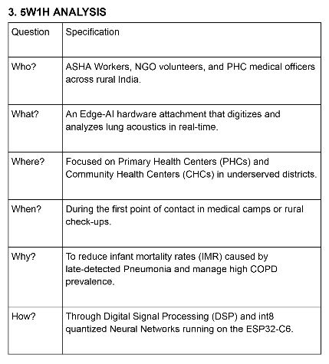
5W1H

Slide 7
Thank
You

